Slide 1



ASE 2024
Exploring Parameter-Efficient Fine-Tuning of Large Language Model on Automated Program Repair
Guochang Li, Chen Zhi*, Jialiang Chen, Junxiao Han, Shuiguang Deng*
* Corresponding authors
Notes:
Thanks for the introduction，Good afternoon everyone. My name is Guochang Li， a phd student of Zhejiang university, I am going to introduce our work， titled “Exploring Parameter-Efficient Fine-Tuning of Large Language Models on Automated Program Repair,” this work aims to apply parameter-efficient fine-tuning methods to automated program repair， to improve the fixing capacities of large language models

Slide 2
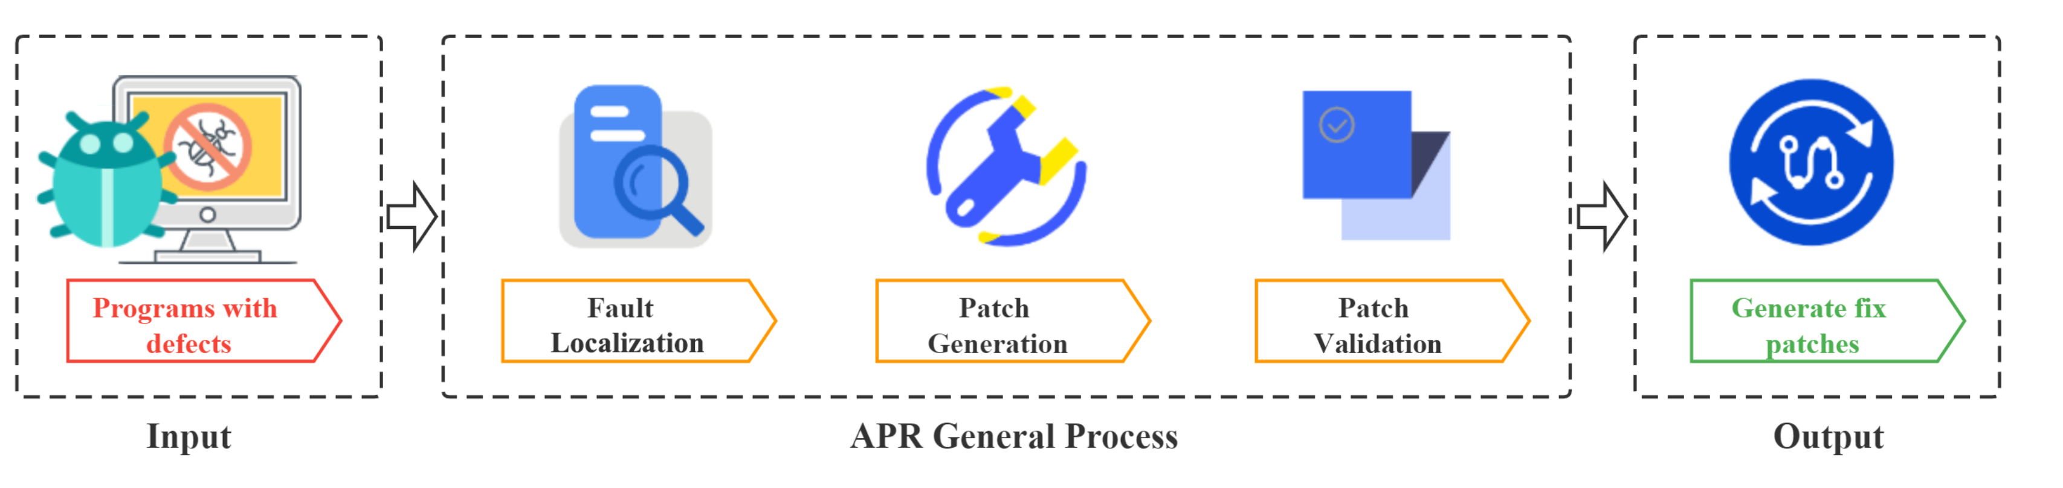


Background
Automated Program Repair（APR）Process
Patch generation is a Seq->Seq task, which is compatible with LLM
Input
Output
Buggy Code with Location
Fixed Code
A Survey on Automated Program Repair Techniques
Notes:
Let’s start with the process of Automated Program Repair, shortly APR. The process takes the code with defects as input.
First,we locate the buggy line, then generate a patch and validate the patch, once validation is passed, the process is ended and we get the fix code as the output.
so look at the patch generation, which takes buggy code with location as input and fixed code as output . In fact, patch generation can be formated as a sequence-to-sequence (Seq-to-Seq) task, making it compatible with large language models (LLMs

Slide 3
HOW to adapt LLM to APR: challenges
DATA：Instruction-tuning enables LLMs to align the training objectives with downstream tasks
But there is a lack of APR-specific instruction datasets for APR tasks.
Construct APR-INSTRUCTION
Fine-tuning METHODS: Full-Model Fine-Tuning (FMFT) can activate LLM potential of APR training with APR data
But FMFT demands significant computing resources which may be not practical for all users
Parameter-Efficient Fine-Tuning
EVALUATION：Several SE tasks that employ PEFT, such as code completion, docstring generation, and code clone detection evaluated by NLP metric
But BLUE metrics do not reliably measure the functional correctness of the generated code, which APR requires generated patches that can be merged into the original code and executed correctly.
Execution-based evaluation for APR by test cases
Notes:
So next question is how to adapt LLM to APR.
Fine-tuning absolutely comes first. But there are several challenges
Since Instruction-tuning enables LLMs to align the training objectives with downstream tasks ， but there is a lack of APR-specific instruction datasets for APR tasks
since… then…

Slide 4
Contribution
Construct APR-specific instruction dataset：APR-INSTRUCTION
This work constructs APR-Instruction by enhancing the existing APR training dataset by adding extra descriptions, which indeed improves fixing capabilities of LLMs on APR.
This work shows CodeLlama-7B with all PEFT methods fixes 7.2%-31.3% more bugs than no fine-tuning, and reduce around around 45.6%-50.0% peak GPU memory usage compared to FMFT, showing the effectiveness and efficiency of PEFT on APR.
This work shows DeepSeek-Coder-Base-6.7B with (𝐼𝐴)³ achieves the best fixing capability, fixing 58% more bugs than the SOTA technique.
This work investigates multiple factors that potentially influence the fixing capability of PEFT methods, including scales of LLMs, type of pre-training data, and base models.
This work demonstrates that (𝐼𝐴)³ achieve the best fixing capability, benifiting from its superior creativity improvement through SFT compared to the other three PEFT methods, possibly.
This work further explores the impact of hyperparameters of PEFT and the size of instruction dataset to improve the efficiency of PEFT.
This work, including APR-Instruction, code, and weights, has been publicly released on [1] to allow researchers to further extend it to other software engineering tasks.
Fine-tuned 4 base models：CodeLLaMA-7B， CodeLLaMA-13B， DeepSeek-Coder Base 6.7B and LLaMA-2-7B with 4 PEFT methods：LoRA， p-tuning， prefix-tuning and (IA)³，analyze the fixing capacities to show the effectiveness and efficiency of PEFT methods
Instruction dataset，Code and so on is open-sourced
Notes:
here is the contribution of this paper， Above all， there are three main contribution。

Slide 5
EXPERIMENT DESIGN:Overview
An overview of APR-Instruction constructed, supervised fine-tuning on four LLMs with four PEFT Methods, and Evaluation on three benchmarks
Notes:
This figure shows the overview of this work， which consists of two parts， apr-instruction construction and SFT and validation.
Let’s dive into the SFT and validation first

Slide 6
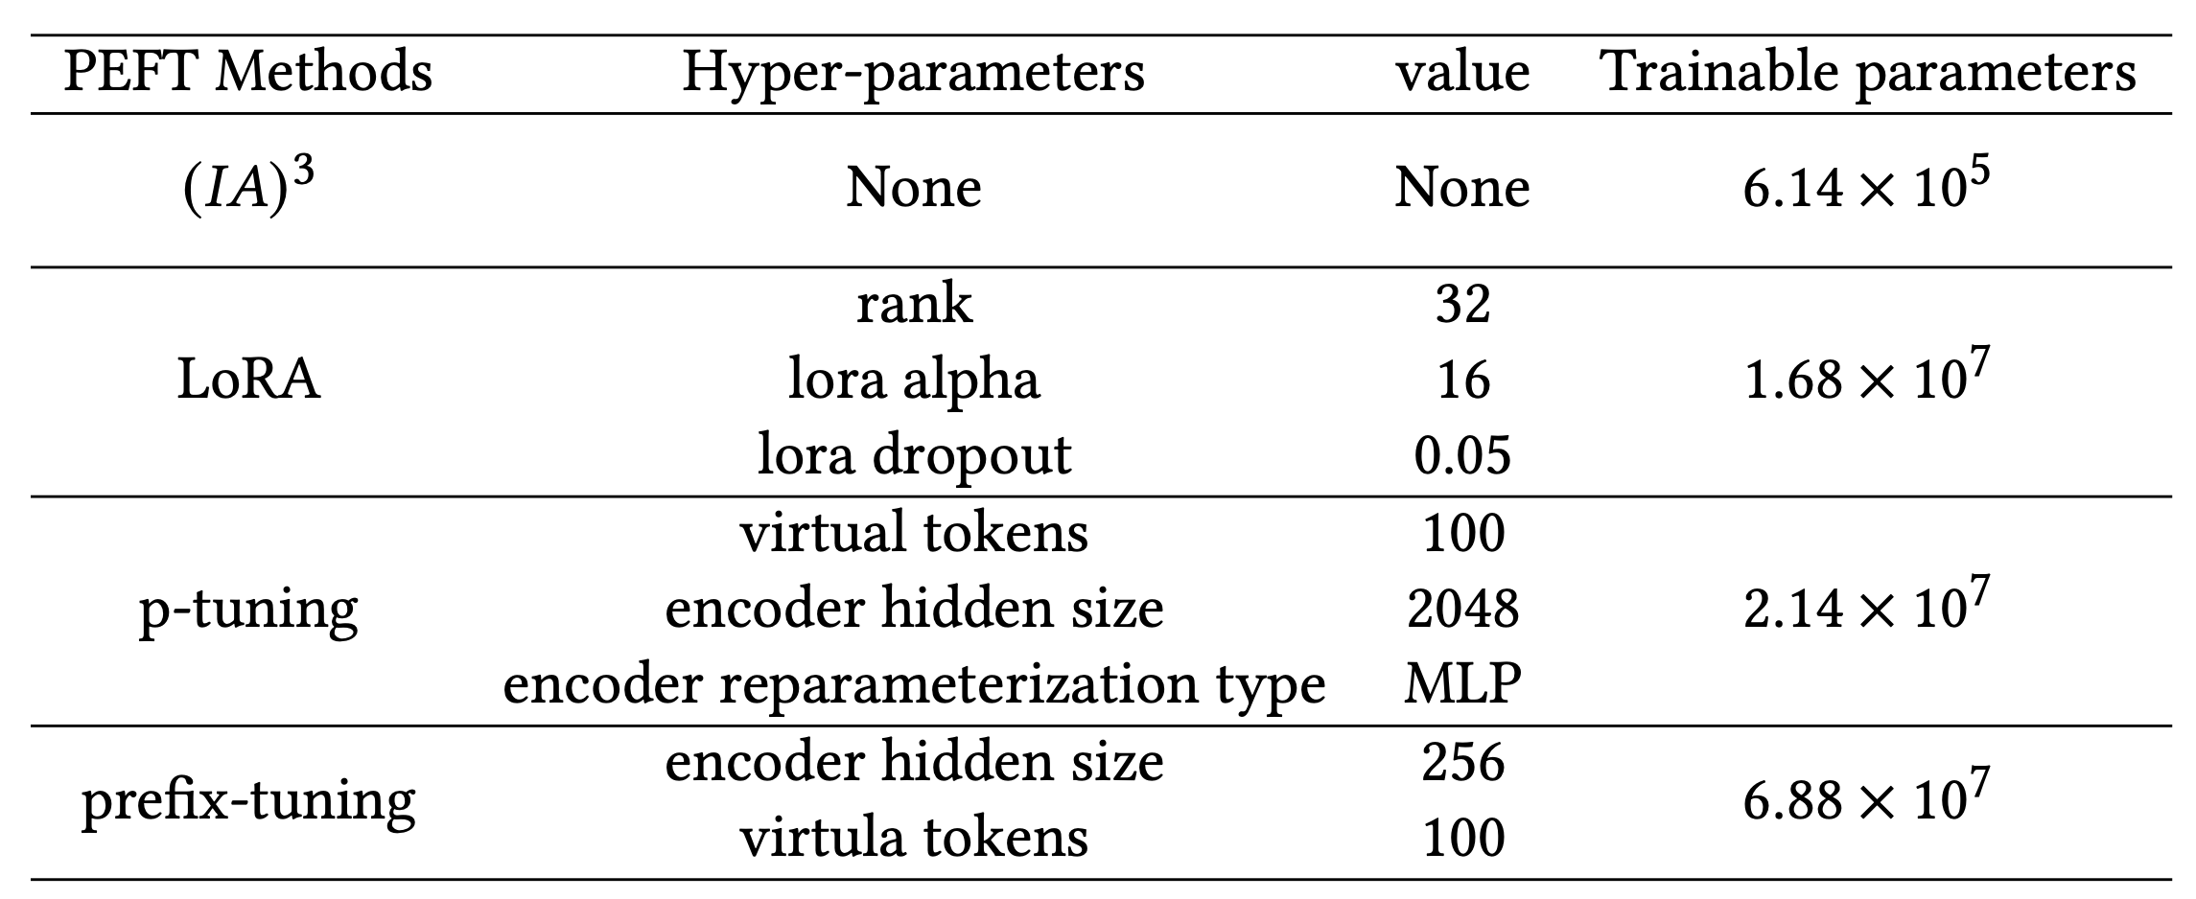
EXPERIMENT DESIGN : PEFT（Fine-tuning Methods）
Main idea of PEFT：froze the parameters of base model to keep the core capacity generation of LLM and fine-tuning small number of parameters to adapt to downstream task
Use 4 different PEFT methods
LoRA & p-tuning v2 &Prefix-tuning & (IA)³
Ensure the fairness in the comparison of different PEFT methods:
maintain consistent magnitudes of trainable parameters among different PEFT methods by adjusting hyperparameters of different PEFT methods
Notes:
Before we step into the technical details， let‘s first introduce the concept of parameter-efficient Fine-tuning， shortly PEFT.
First of all， PEFT methods are fine-tuning methods. The main idea of PEFT is freezing the initial parameters of base model to keep the core generation capacity of LLM and fine-tuning small number of parameters to adapt to downstream task， such as LoRA.
In this paper， we use 4 different and common peft methods to fine-tune the base model. The red part of the left figure represents the parameters that need to be fine-tuned for different PEFTs in the transformer model.
In subsequent experiments, we maintain consistent magnitudes of trainable parameters among different PEFT methods on the same base model， to keep the the fairness in the comparison of different PEFT methods
The details are shown on the right table， while you can see （IA）3 can not change the nunber of trainable parameters

Slide 7
EXPERIMENT DESIGN : Benchmarks and Evaluation Metric
Use 3 existing benchmarks:
Defects4J & QuixBugs & HumanEval-Java
Single-hunk bugs are selected
Patch generation and validation:
LLMs generate 10 candidate patches for each example
Test cases are used to check the correctness of patches
A sample of the plausible patches have been checked manually
Evaluation Metric:
pass@k
In the subsequent experiments, we report the 𝑝𝑎𝑠𝑠@10 metric for each benchmark.
Notes:
Another experiment design is the Benchmarks and Evaluation Metric
We use three common APR benchmark， Defects4J & QuixBugs & HumanEval-Java with single-hunk bugs,
LLMs generate 10 candidate patches for each example
Since we use test cases to check the correctness of patches， we use pass@k as metric
In the subsequent experiments, we report the 𝑝𝑎𝑠𝑠@10 metric for each benchmark

Slide 8
EXPERIMENT DESIGN : APR-Instruction Construction
[1]
Evaluation of overlap between APR-Instruction and benchmarks(no overlapping between the instruction dataset APR-Instruction and three benchmarks):
The collection of APR-Instruction has excluded these benchmarks.
Prior work uses this existing APR dataset for training and also conducts evaluation on Defects4J, QuixBugs, and Humaneval-Java.
Evaluation of APR-Instruction validity:
Initially produce nearly 100 samples and conduct a manual inspection, finding no anomalies.
Even if there is some inaccurate data, prior studies suggest that not removing noisy data can actually improve performance.
[1] A Syntax-Guided Edit Decoder for Neural Program Repair ECSE/FSE 2021
Notes:
Another essential part is APR-Instruction Construction， we use an existing APR dataset， which consists of buggy code and fix code pairs,
based on buggy code and fix code pairs, we use prompt-engineering to guide gpt3.5 generate additional information， such as function description of buggy code and description information of buggy code， and fix code is regarded as label
Finally， we got the APR-INTRCUTION
The reviewers expressed concerns about the overlap between APR-Instruction and benchmarks and validity of APR-INSTRUTION
For overlap，on the one hand the collection of the existing APR dataset has excluded the three benchmarks

Slide 9
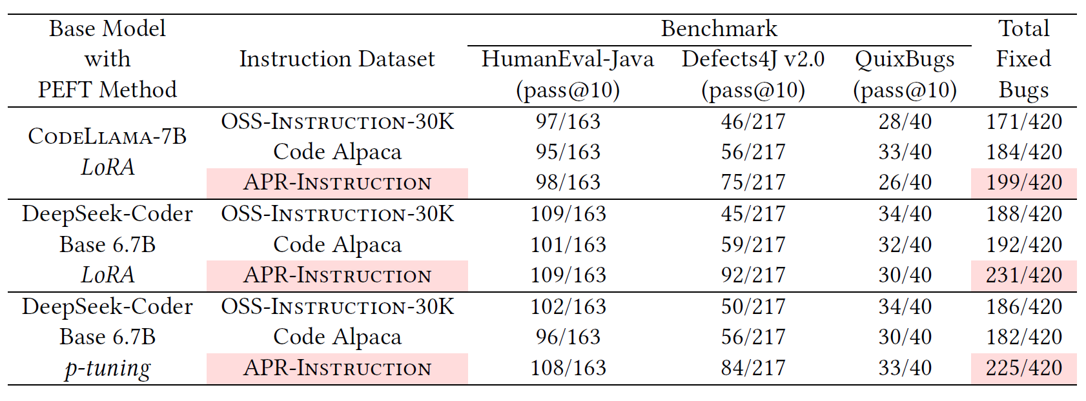
EXPERIMENT DESIGN: Impact of APR-INSTRUCTION(task-specific dataset really works？)
eliminate the influence of the base model on fixing capabilities
exclude the impact of the PEFT method on fixing capabilities
Compared with two other general Code Instruction Dataset:
Code Alpaca
OSS-Instruction
In conclusion, APR-Instruction significantly enhances fixing
capabilities through fine-tuning.
Notes:
The question comes， since there are so many general code instruction， task-specific dataset really works？ We made a comparison with other two general code instruction dataset widly used, code alpaca and oss-instruction
To eliminate the factor of the base mode，we fine-tuned codellama-7B and deepseek-coder base 6.7B with the same pEFT method，Lora Separately。
And to exclude the impact of the PEFT method， we conduct the fine-tuing on the same base model and different peft methods. Among All the experiments，apr-instruction achieve the best， which we can see task-specific dataset really works compared general code instruction dataset
Results showed that APR-INSTRUCTION consistently improved patch generation, confirming the benefit of using a task-specific dataset.

Slide 10
EXPERIMENT RESULTS: Research Questions
RQ1: How do PEFT methods effectively and efficiently improve the fixing capabilities of LLMs compared to no fine-tuning and SOTA APR techniques?
RQ2: How do different PEFT methods improve the fixing capabilities of LLMs fine-tuned on different base LLMs?
RQ3: How do PEFT hyperparameters and the size of instruction dataset affect fixing capabilities of LLMs on APR?
Try to answer:
Are PEFT Methods useful, for effectiveness and efficiency?
Try to answer:
How to activate capabilities of PEFT methods?
Try to answer:
Anything else to improve the effectiveness and efficiency of PEFT methods?
Notes:
After set the experiment，there are three RQ for this work. Logically, if we would like to apply PEFT to APR， we should first prove PEFT really works， which means peft can improve the fixing capacities of LLM,
After that， we try to explore How to activate capabilities of PEFT methods?
At last， we try to explore anything else to improve the effectiveness and efficiency of PEFT methods?

Slide 11
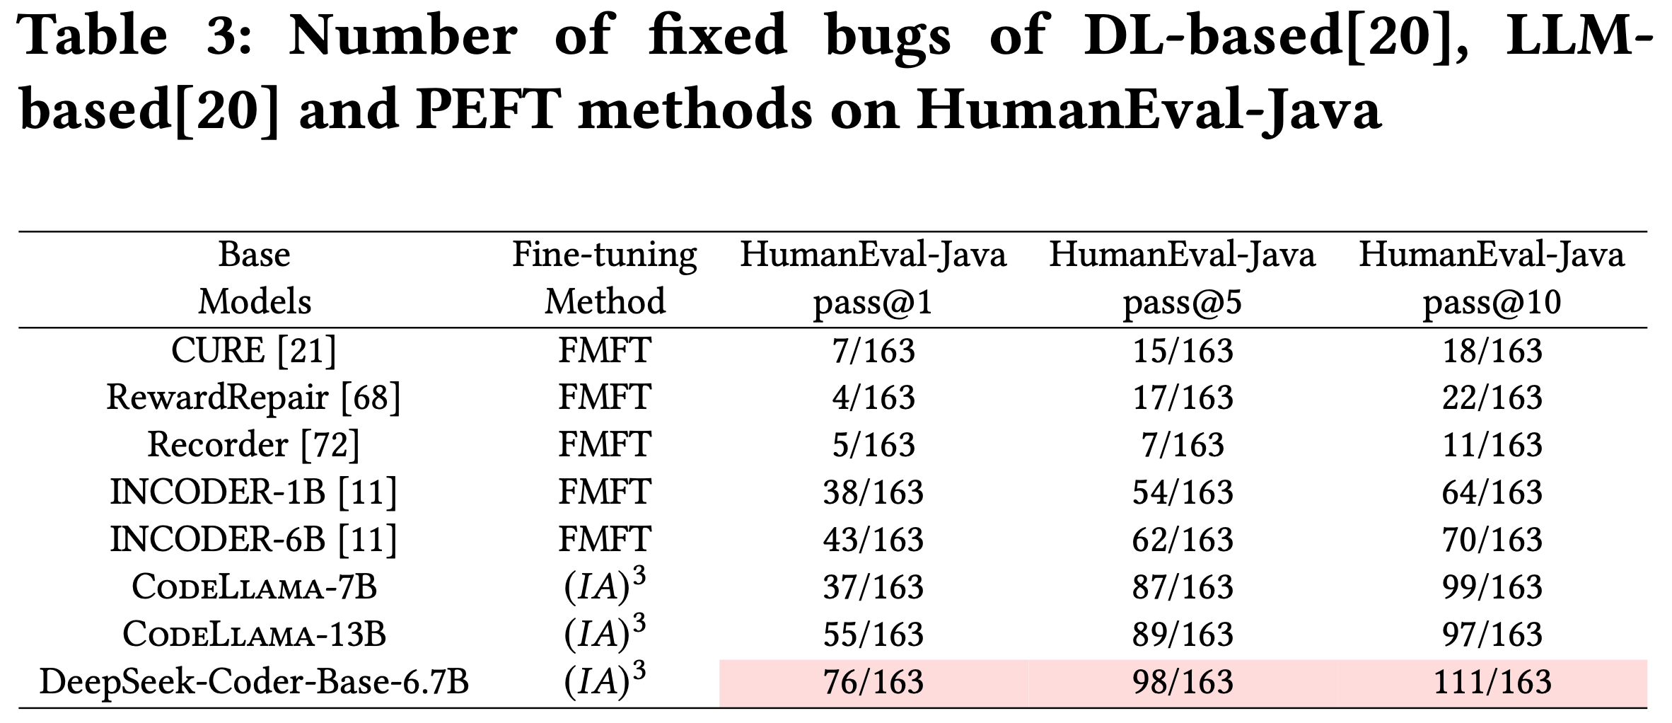
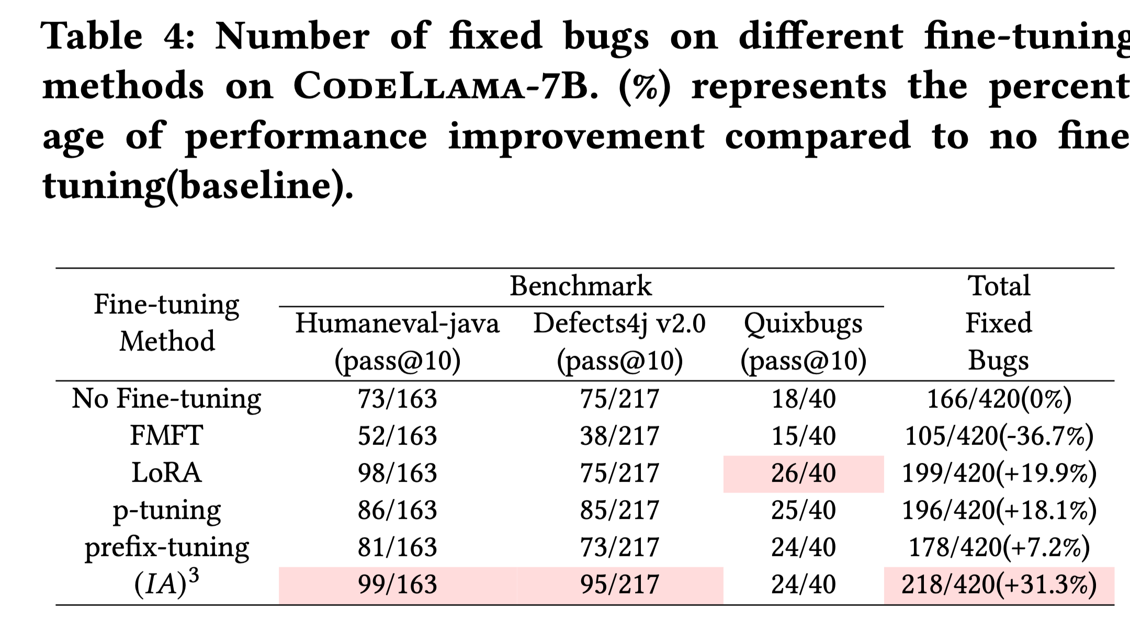
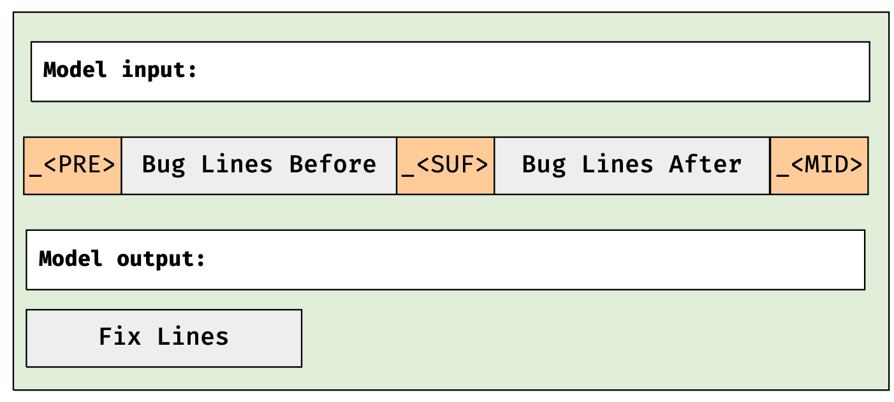
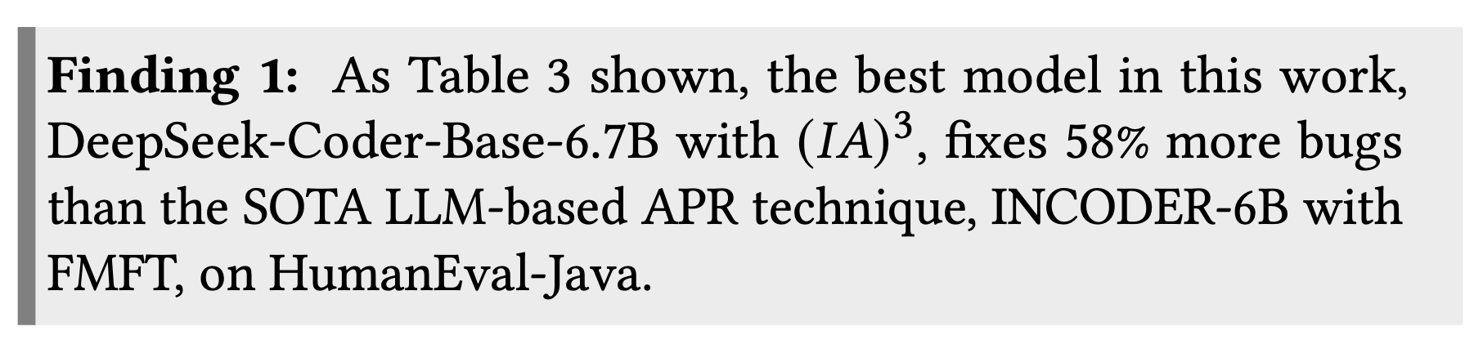
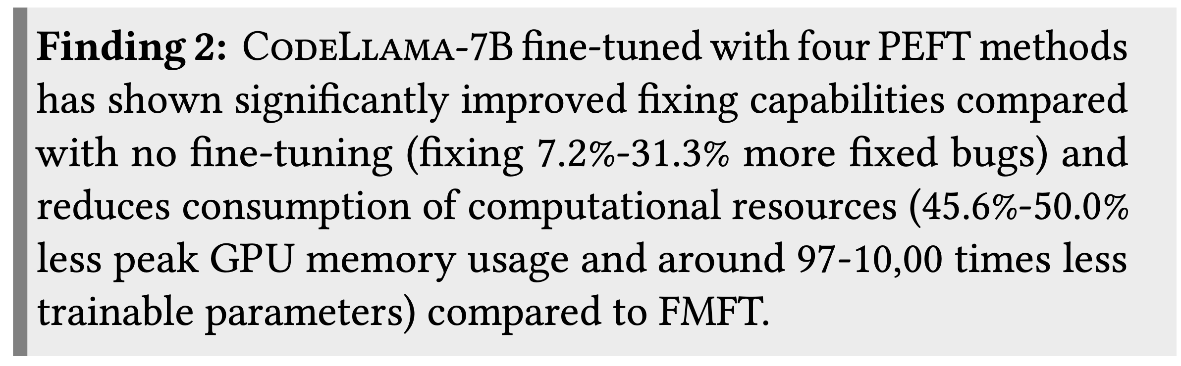
RQ1: Fixing Capabilities and Computing Resource Consumption of PEFT（compared with SOTA and baseline）
Analysis of Fixing Capabilities:
DL-Based methods
LLM-Based methods
Filling in the Middle Format
Outperform than SOTA Methods in Humaneval-Java
Outperform than no fine-tuning
Notes:
We demonstrate the usefulness of PEFT as a fine-tuning method from two perspectives， Fixing Capabilities and Computing Resource Consumption.
First，we conduct the experiment to compare peft with sota dl and LLM-based methods，which shown in the left table.
No fine-tuning in general is considered a lower bound of the PEFT method， while full model fine-tuning (FMFT) is generally considered an upper bound.
to improve the performance of no ft, we use filling in the middle format. Eventually，the fixing capacities of peft outperforms sota dl-based and LLM-based method and no Fine-tuning， which is the
baseline

Slide 12
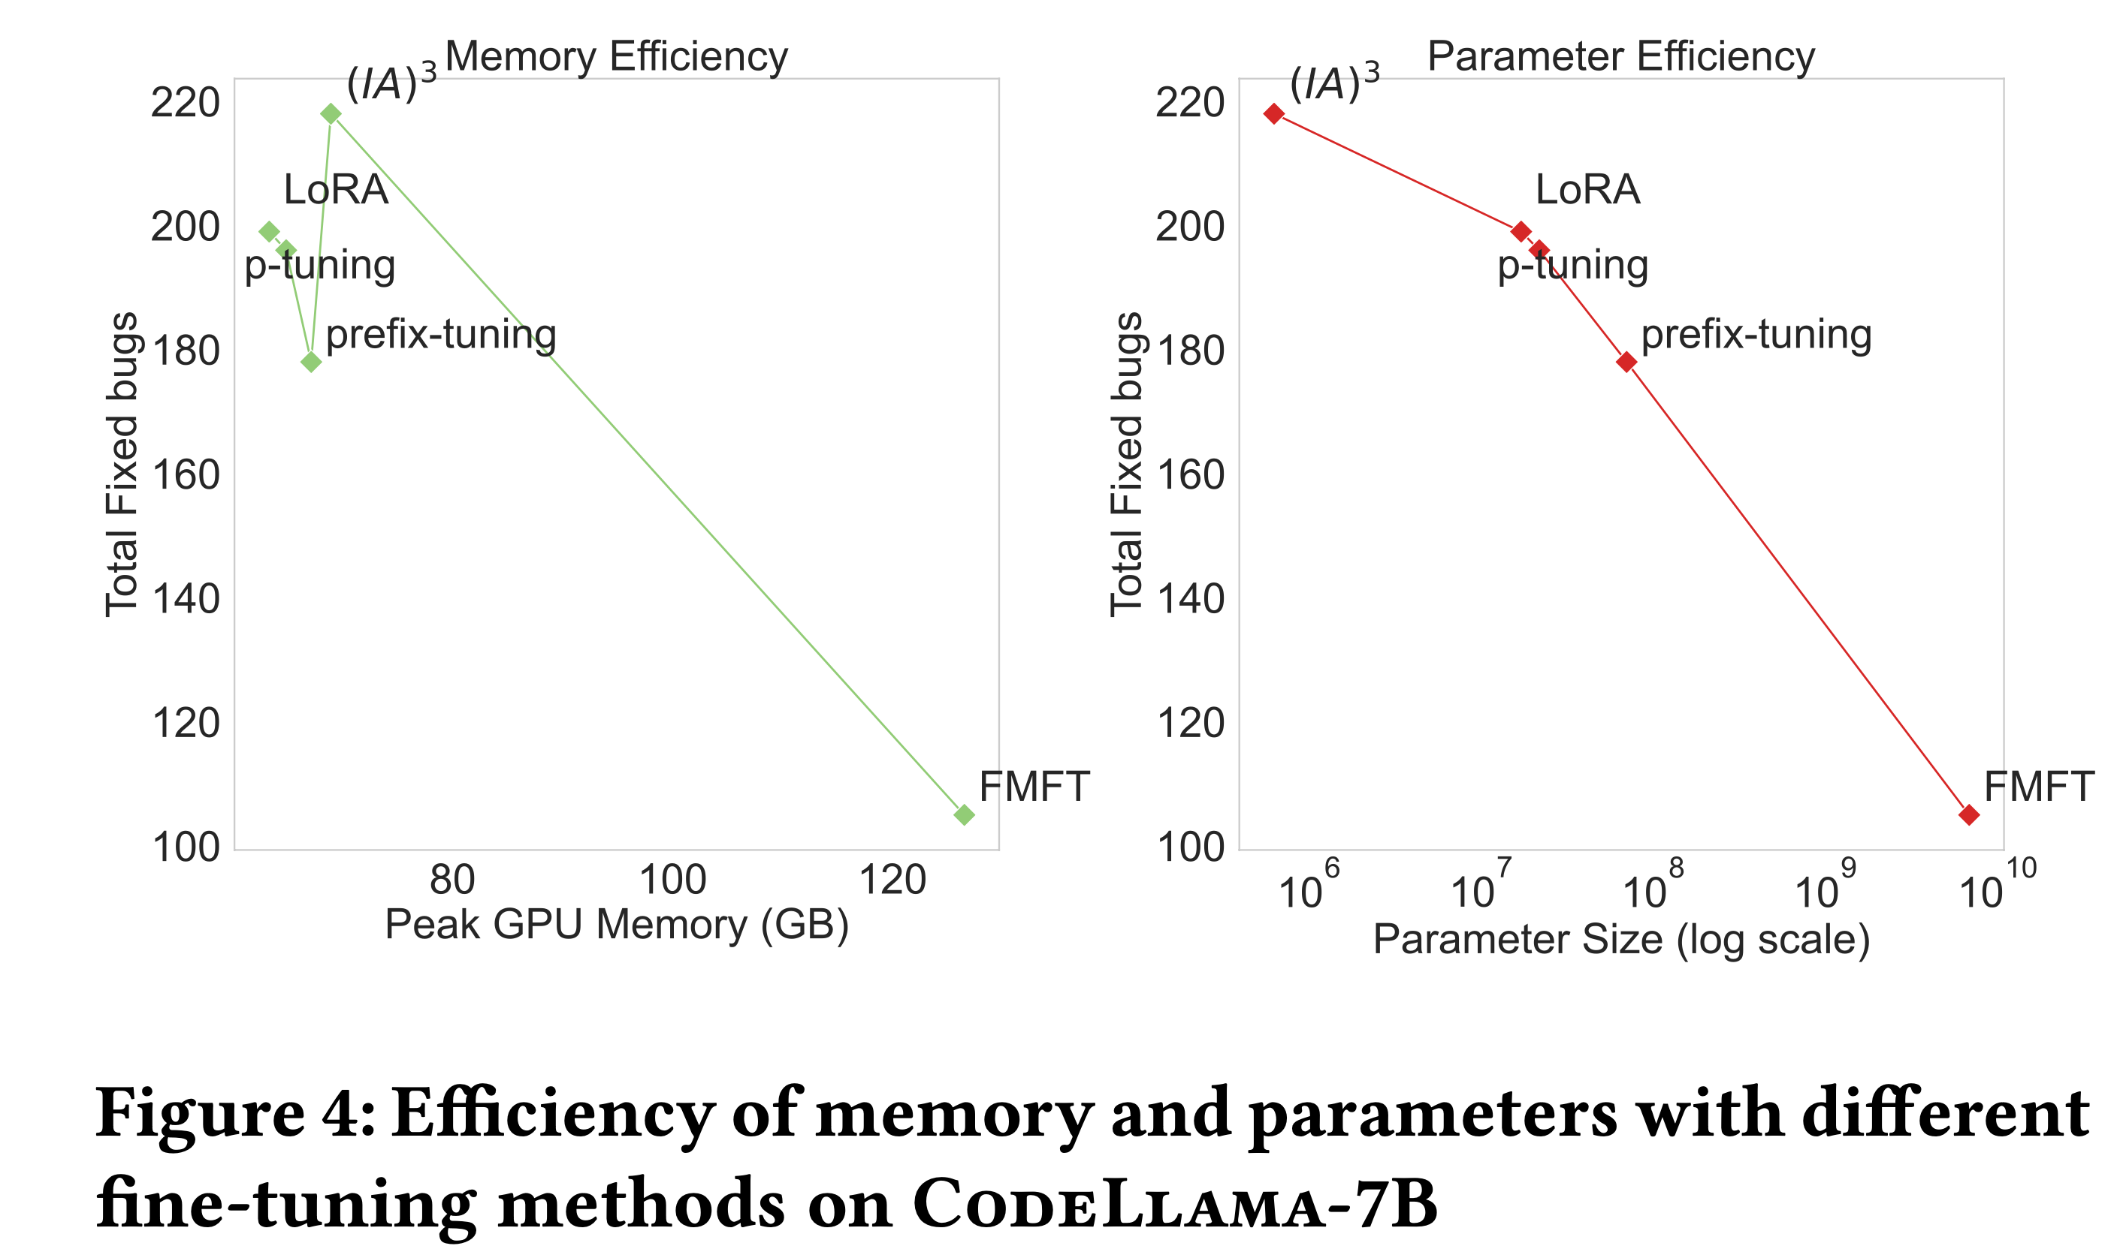
RQ1: Fixing Capabilities and Computing Resource Consumption of PEFT（compared with Full-Model Fine-Tuning）
Analysis of Computing Resource Consumption:
Reduces consumption of computational resources (45.6%-50.0%
less peak GPU memory usage and around 97-10,00 times less trainable parameters) compared to FMFT.
Notes:
For the efficiency， as the left figure shows， peft nearly Reduces 50% consumption of computational resources compared with fmft.

Slide 13
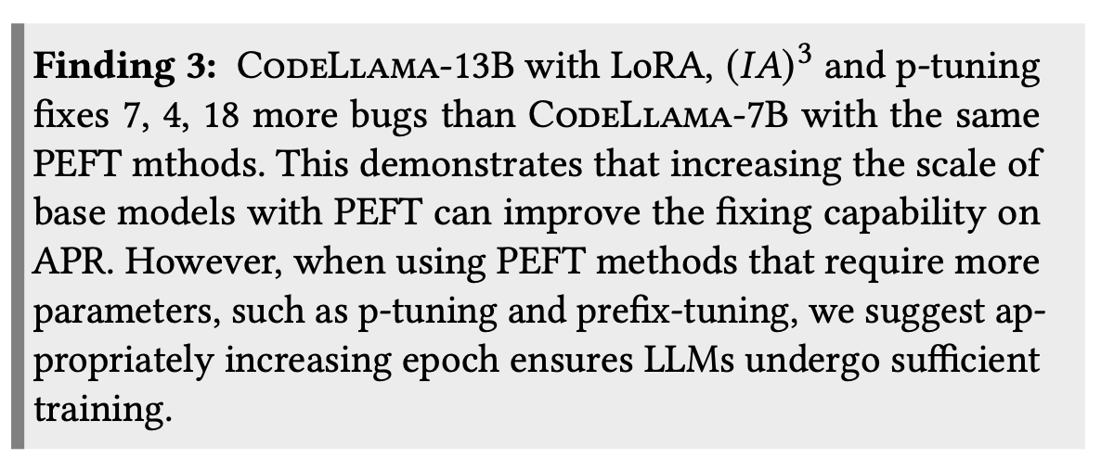
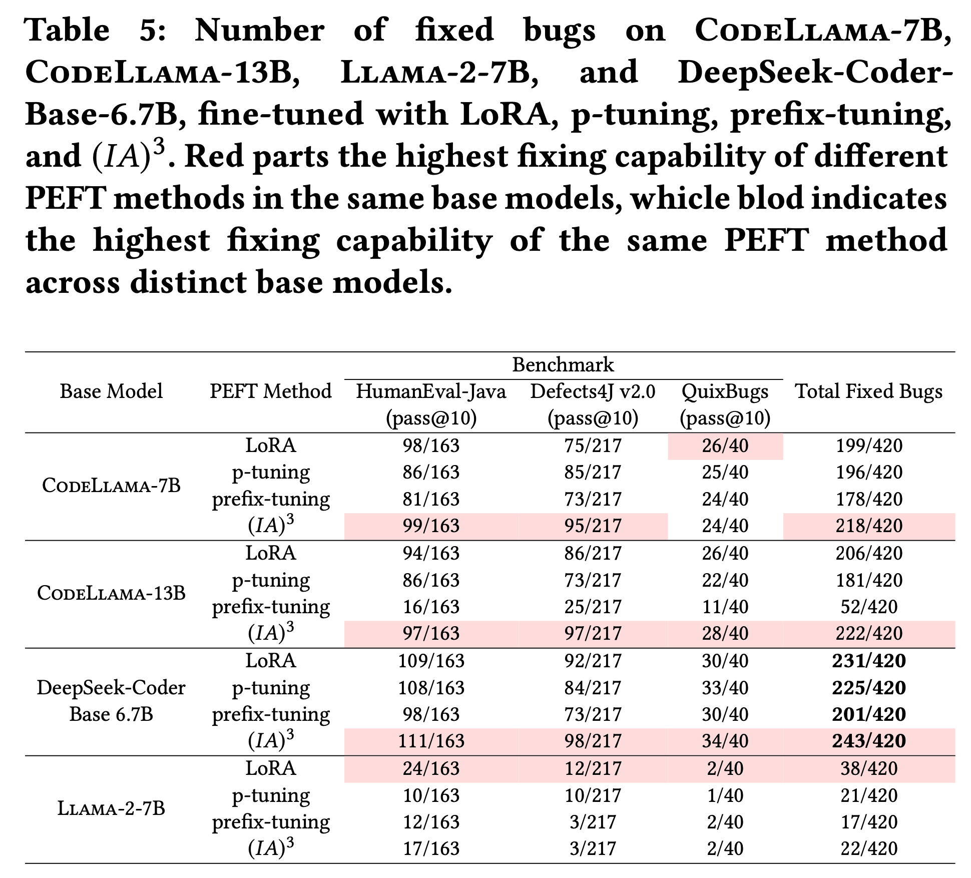
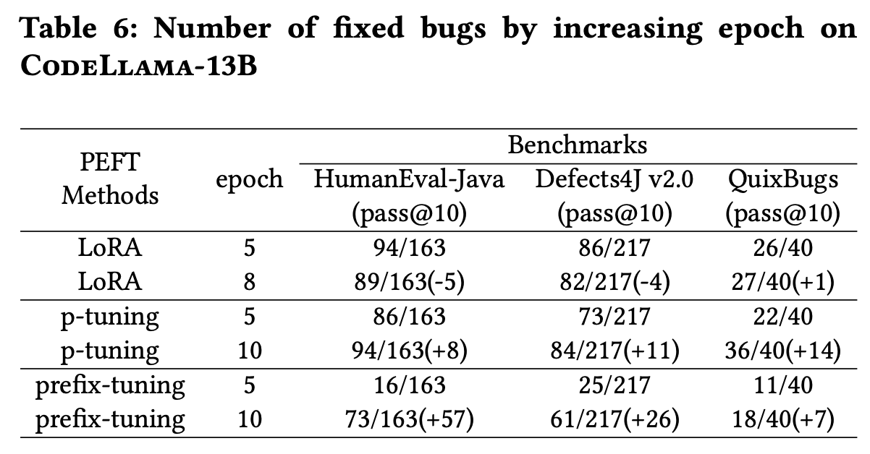
RQ2: Fix Capabilities in Different PEFT Methods Based on Different LLMs(More parameters better?)
CodeLlama-7B vs CodeLlama-13B
Notes:
so by the rq1， we know that peft is useful. So the next question is how do we use it？ For example， which base model and peft methods should we select to ft？
We conduct several experiments to explore it. We fine-tuned 4 different base models with 4 different peft methods， total 16 models.
The first factor we want to explore is whether more parameters of base mmodels better， so we compere the fixing capacities of codellama-Seven billion and codellama-13b with the same peft methods。
For Ia3 and lora， the fixing capacities of codellama-13 is better than codellama-7.
We have observed that the fixing capacities of p-tunig and prefix-tuning，

Slide 14
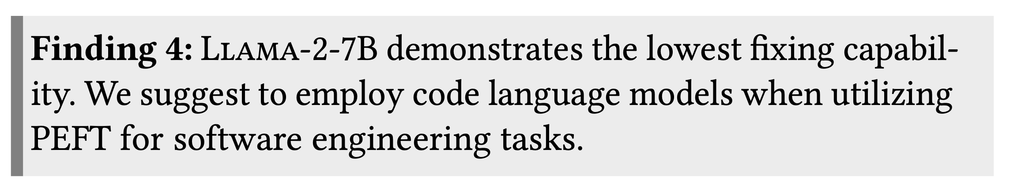
RQ2: Fix Capabilities in Different PEFT Methods Based on Different LLMs (Code-specific or text-specific?)
CodeLlama-7B vs Llama-2-7B:
Notes:
Intuitively， Code-specific LLM can do better in code task than text-specific models
To prove this， we conduct the experiment

Slide 15
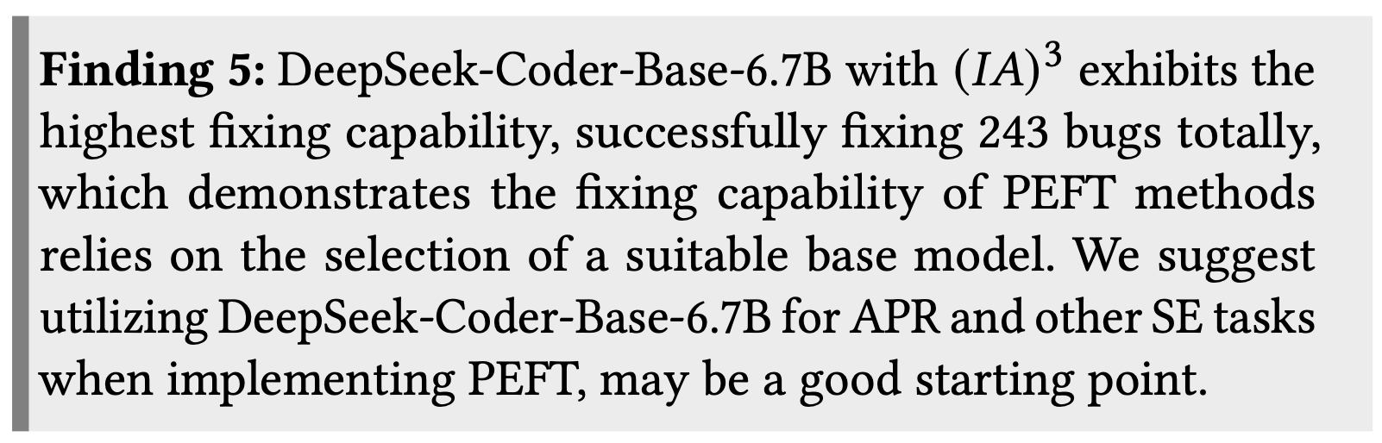
RQ2: Fix Capabilities in Different PEFT Methods Based on Different LLMs (Different pretraining with same scale of parameters?)
CodeLlama-7B vs DeepSeek-Coder-Base-6.7B
Notes:
Another experiment is conducted to show the impact of Different pretraining base models with same scale of parameters
By the way， deepseek-coder with ia3 achieves the best performance among all experiments， even better than codellama-13b
The selection of the base models is really import for peft methods

Slide 16
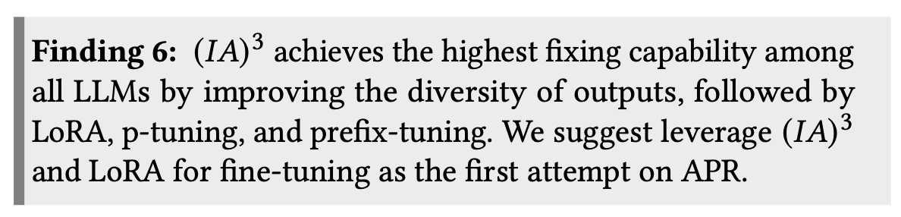
RQ2: Fix Capabilities in Different PEFT Methods Based on Different LLMs (Impact of different PEFT Methods?)
(IA)³ > LoRA > p-tuning > prefix-tuning
(IA)³ achieves the best, so why?
Notes:
All experiments are conducted from the perspective of the base model.
let‘s focus on the same base model with different peft methods
We can conclude that (IA)³ > LoRA > p-tuning > prefix-tuning

Slide 17
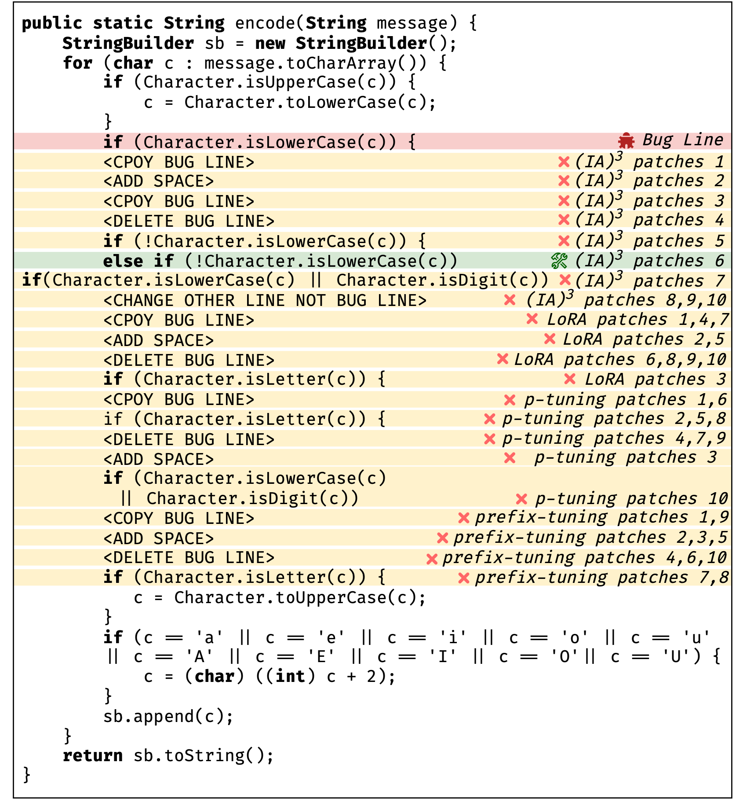
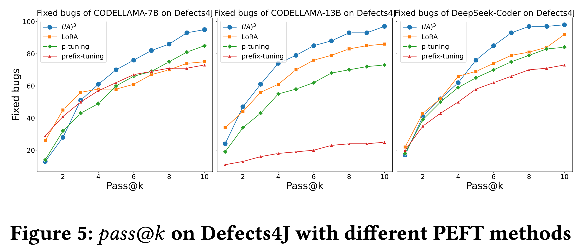
A case study for different PEFT methods
(IA)³ improving the diversity of outputs, is it right?
(IA)³ improving the diversity of outputs, it is right!
Notes:
Candidate patches of lora p-tuning prefix-tuning can be Stubborn

Slide 18
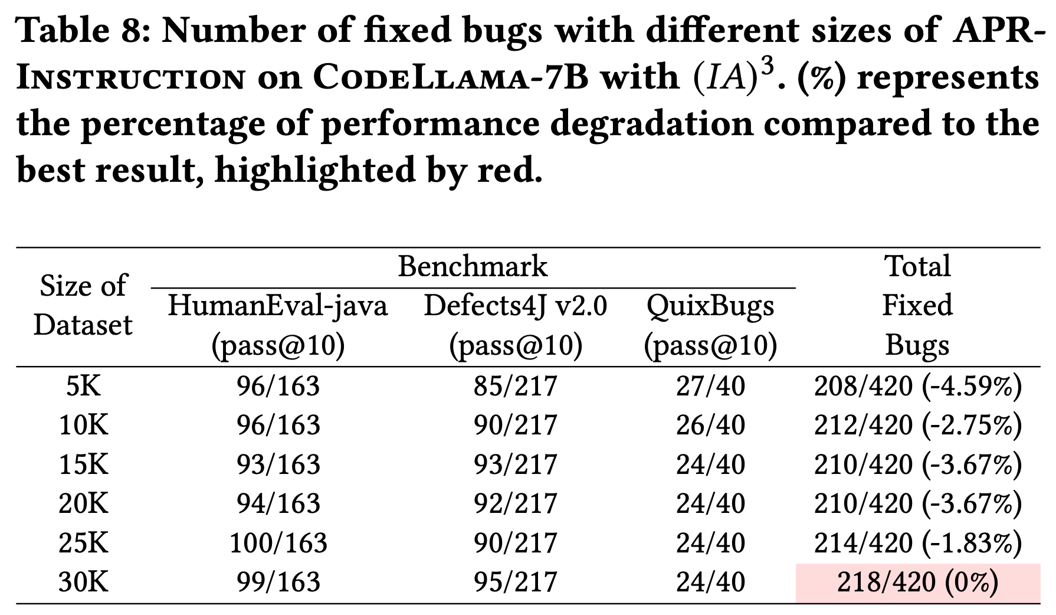
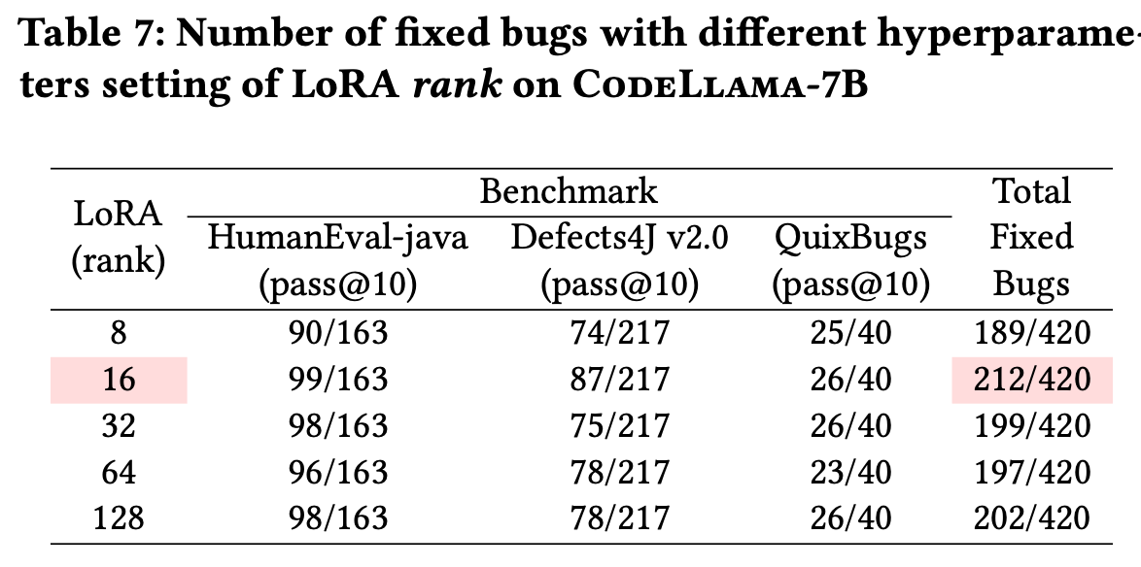
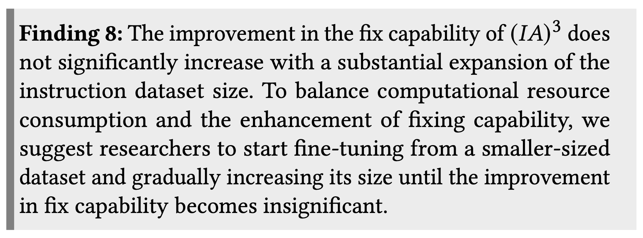
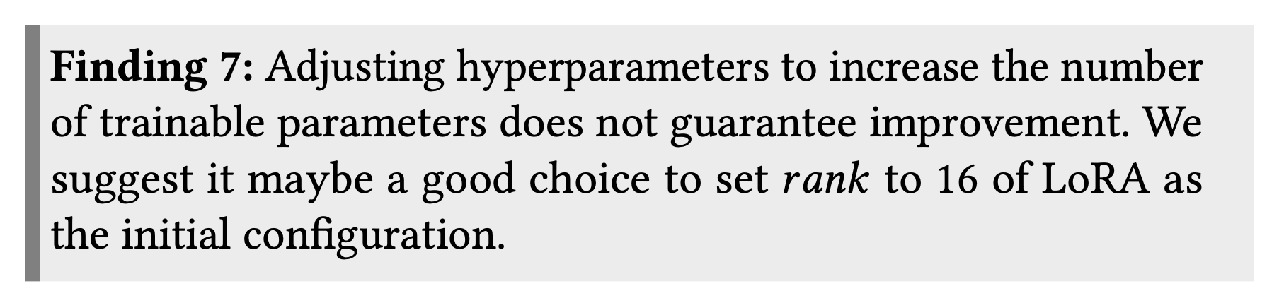
RQ3: Exploration of Hyperparameters Setting and Sizes Setting of Instruction Dataset
Impact of Hyperparameters Setting
Impact of Instruction Dataset Size

Slide 19








Conclusion-What did the work do?
Give me an existing dataset
Give me base LLMs
Some PEFT methods
Extend it to an instruction dataset
Fine-tuning
Inference and validation by execution-based mehods
Above all, a roadmap given to make LLM adapt to the specific SE task with PEFT methods

Slide 20
Thanks!
And any questions?

